Slide 1
Introduction to the Roman Empire
A Brief Overview of Rome's Great Civilization

Slide 2
What is the Roman Empire?
The Roman Empire was one of the greatest and longest-lasting empires in history.
It was a civilization that emerged from the city of Rome and grew to encompass a vast territory across three continents: Europe, Africa, and Asia.
The empire lasted for over 1,000 years, from 27 BC to 476 AD, and left a lasting impact on Western civilization.

Slide 3
The Rise of the Roman Empire
The Roman Empire began as a small city-state in central Italy.
Through a series of military conquests and strategic alliances, it gradually expanded its territory and became a dominant power in the Mediterranean region.
The empire reached its peak under the rule of Emperor Augustus, who established a period of relative peace and stability known as the Pax Romana.

Slide 4
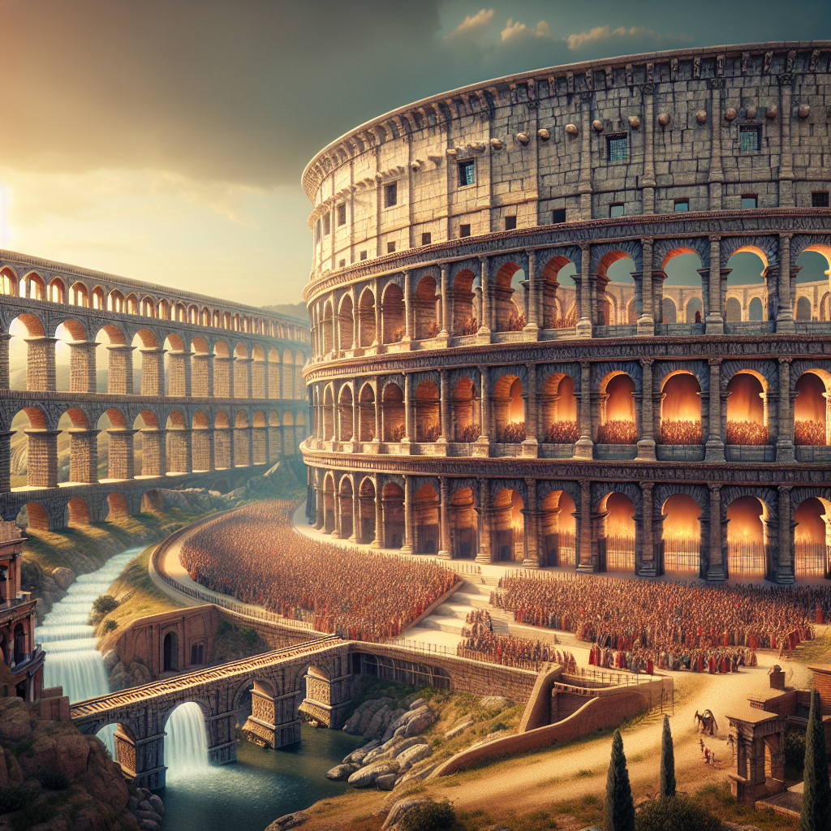
Architecture and Engineering
One of the most impressive achievements of the Roman Empire is its architecture and engineering.
The Romans built magnificent structures such as the Colosseum, which could hold up to 50,000 spectators and was used for gladiatorial contests and other public spectacles.
They also constructed a vast network of aqueducts to bring clean water to cities and towns throughout the empire.
Colosseum

Slide 5
Law and Governance
The Roman Empire had a well-developed legal system based on a set of laws known as the Twelve Tables.
These laws provided equal protection to all citizens and established the principle of innocent until proven guilty.
The empire was also governed by an emperor who held absolute power, although there were also institutions such as the Senate and assemblies that played a role in decision-making.

Slide 6
Religion and Mythology
Religion played a central role in Roman society.
The Romans worshipped a pantheon of gods and goddesses, led by Jupiter, Juno, and Minerva.
They also incorporated elements of Greek mythology into their religious beliefs and practices.

Slide 7
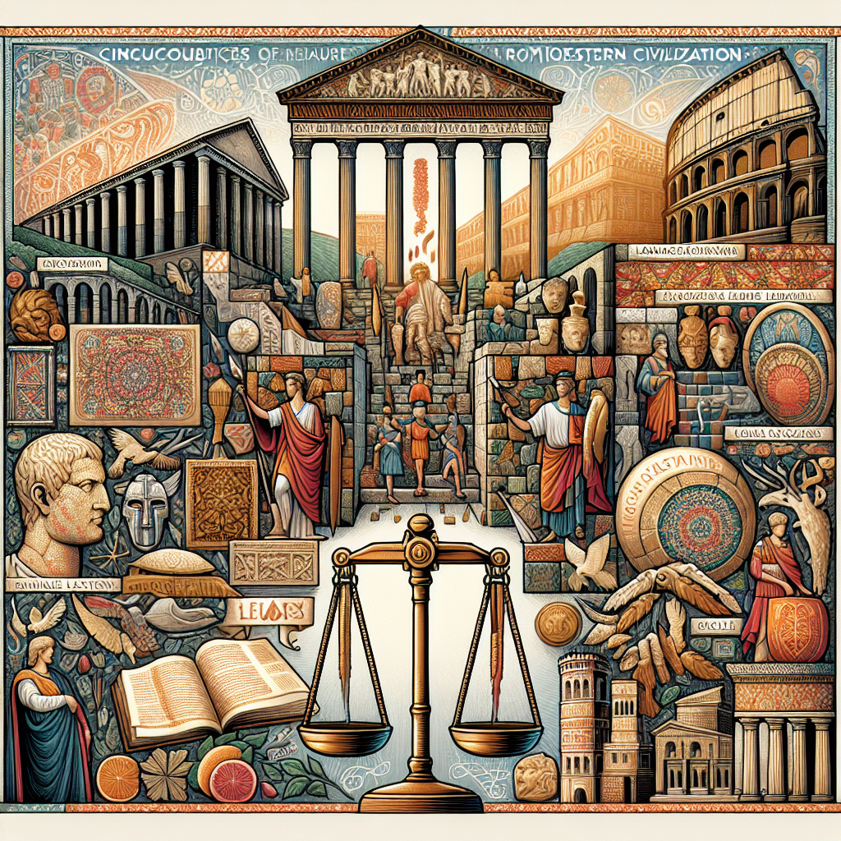
Legacy of the Roman Empire
The Roman Empire has left a lasting legacy on Western civilization.
Its legal and political systems, as well as its architectural and engineering achievements, have influenced subsequent societies.
The empire's cultural and intellectual contributions, such as the Latin language and literature, have also had a significant impact.
Roman Empire

Slide 8
Decline and Fall of the Roman Empire
Despite its grandeur, the Roman Empire eventually experienced a decline and fall.
Internal conflicts, external invasions, and economic difficulties all contributed to its collapse.
The empire was officially ended in 476 AD when the last Roman emperor was deposed.

Slide 9
Influence on Modern Society
Although the Roman Empire no longer exists, its influence can still be seen in modern society.
Many aspects of Western culture, including language, government, and architecture, have been shaped by Roman civilization.
The study of ancient Rome continues to fascinate and inspire people around the world.

Slide 10
Conclusion
In conclusion, the Roman Empire was a remarkable civilization that left a lasting impact on the world.
Its achievements in architecture, law, and governance continue to inspire and influence us today.
By studying the history of the Roman Empire, we can gain insights into the complexities of human culture and the rise and fall of great civilizations.

Slide 11
References
1. Grant, M. (1978). The History of Rome. Faber & Faber.
2. Beard, M. (2015). SPQR: A History of Ancient Rome. W. W. Norton & Company.
3. Woolf, G. (2012). Rome: An Empire's Story. Oxford University Press.

Slide 12
Thank You
Thank you for your attention!
Any questions?

